Slide 1

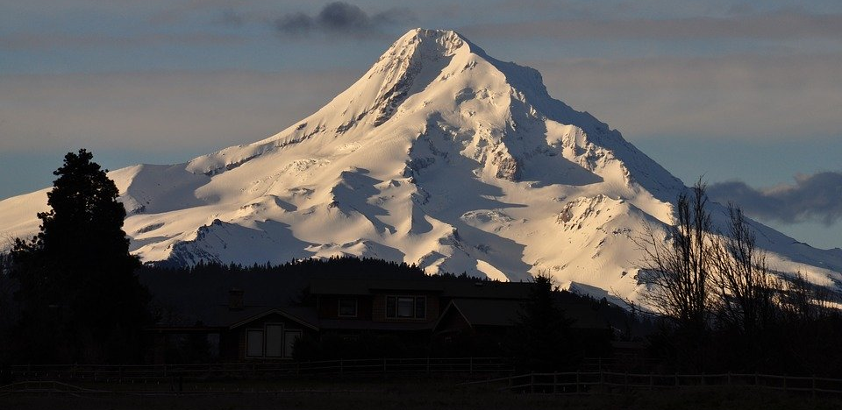
Educated Relocation
John Williams

Slide 2
Capstone Presentation
Applied Data Science Capstone – IBM - Coursera

Slide 3

Introduction
Our hypothetical client is planning a move to the Pacific Northwest
Moving can be hard
They want to land in a neighborhood they’d enjoy
They don’t know anything about the neighborhoods in the Pacific Northwest

Slide 4
Intro- cont’d
They do know two neighborhoods they’ve enjoyed previously
Hampden, Baltimore, MD
Decatur, GA
Based on venue types in the known neighborhoods, we will try to find potential neighborhoods that they’d enjoy

Slide 5
Data
opendata.arcgis.com : Generate a list of neighborhoods in Portland and Seattle
Geolocator to determine neighborhood coordinates
Folium to visually inspect for adequate neighborhood coverage
Foursquare Places API : generate a list of venues in each neighborhood and further explore select venues to determine rating

Slide 6
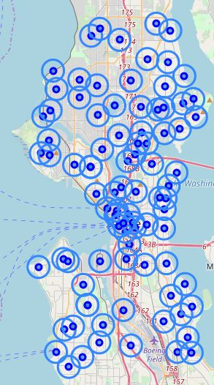
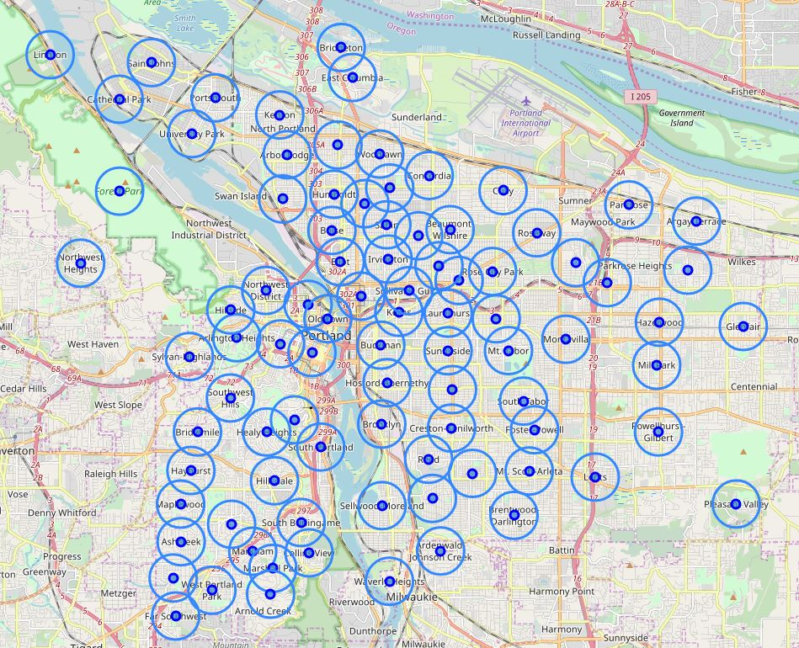
Neighborhood Maps
Portland, OR
Seattle, WA

Slide 7
Method
Clustering
Use K Means clustering to determine which neighborhoods are most similar to Hampden and Decatur
Narrowing
Use client preferences to pick neighborhoods with a park and a grocery store
Ranking
Rank each neighborhood on grocery store rating

Slide 8
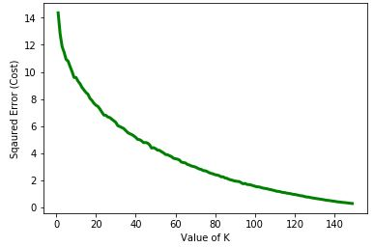
K Means – Elbow Point
Number of clusters versus Squared Error
30 Clusters looked like a reasonable elbow point

Slide 9

Results

Slide 10
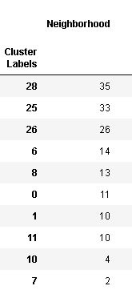
Clustering
Neighborhoods were assigned to 30 clusters
Neighborhoods per Cluster
Hampden and Decatur were in Cluster 25

Slide 11
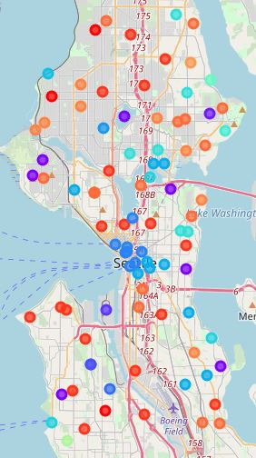
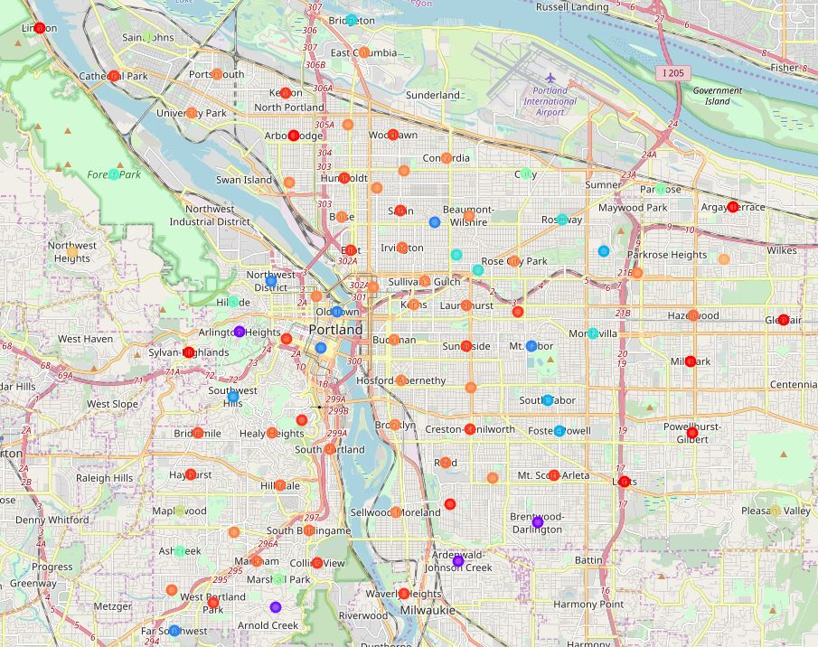
Mapped Clusters
Portland, OR
Seattle, WA

Slide 12
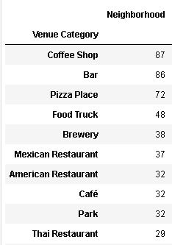
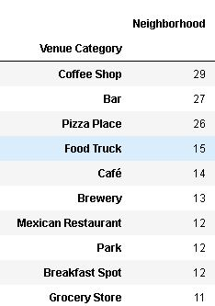
Cluster Characteristics
Hampden and Decatur are in Cluster 25
Top 10 Venue Categories in Cluster 25
Top 10 Venue Categories in Final 8 Neighborhoods

Slide 13
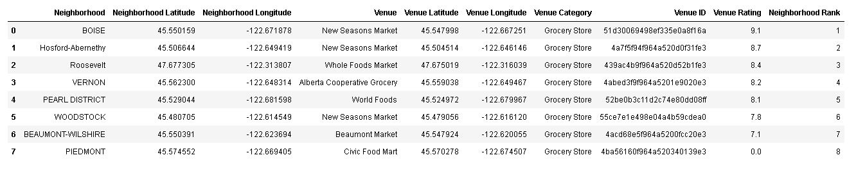
Final Neighborhood Rank

Slide 14
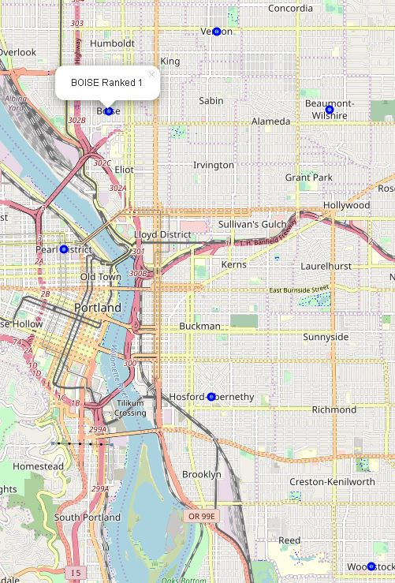
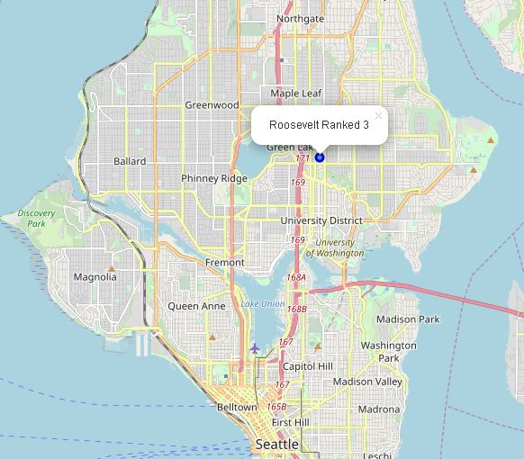
Final Neighborhood Map
Portland, OR
Seattle, WA

Slide 15

Final Neighborhood Ranking
Boise, Portland, OR
Hosford-Abernethy, Portland, OR
Roosevelt, Seattle, WA
Vernon, Portland, OR
Pearl District, Portland, OR
Woodstock, Portland, OR
Beaumont-Wilshire, Portland, OR
Piedmont, Portland, OR

Slide 16
Discussion/Limitations
K Means might not have been the ideal clustering method as no obvious elbow point was present. However, we were able to accomplish the project goal.
Number of venues per neighborhood was limited to 100.
Instead of starting with neighborhoods, we could have used sectors to ensure total coverage without significant overlap.
Limited utility for other clients.

Slide 17
Conclusion
Using venue category in each neighborhood to cluster similar neighborhoods and narrow the list by ensuring each potential neighborhood has a park and a grocery store, the clients now have a list of 8 neighborhoods ranked by grocery store quality to direct their search.

